Slide 1
PRESENTATION TITLE
Amplifier CKT
Team Members:
Eisha
Fatima
Tabinda

Slide 2

Slide Title
AMPLIFIER:
“an electronic device for increasing the amplitude of electrical signals, used chiefly in sound reproduction.”

Slide 3
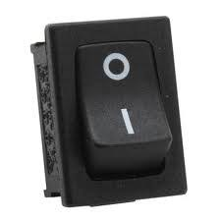
Components:
FOR DC SUPPLY:
Transformer (220V to 24V)
Diode Bridge(4 diodes)
Capacitors
Switch

Slide 4
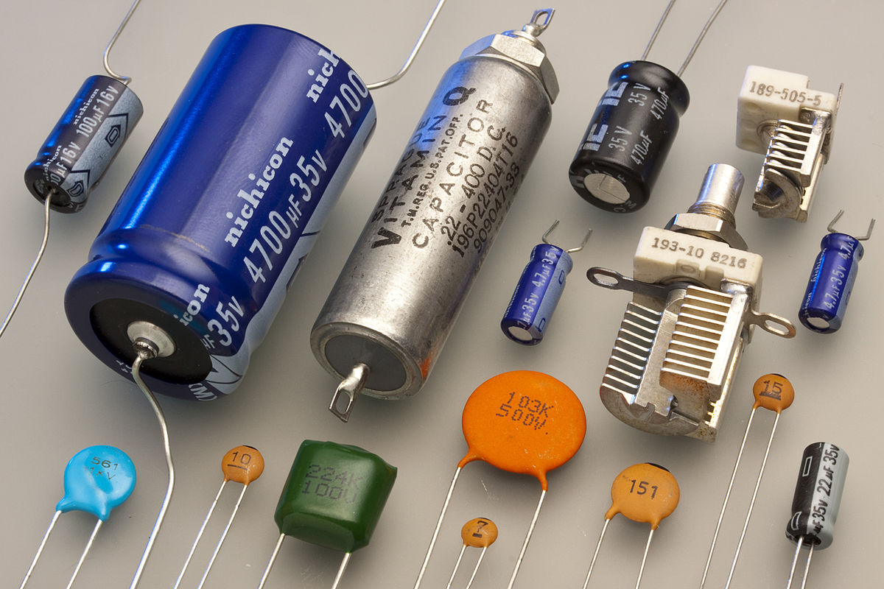
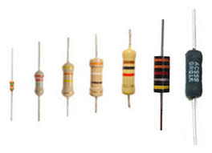
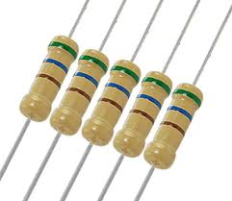
Components:
VR(variable resistor)
Heat Sink
Transistors
Power Transistors
Capacitors
Resistors

Slide 5
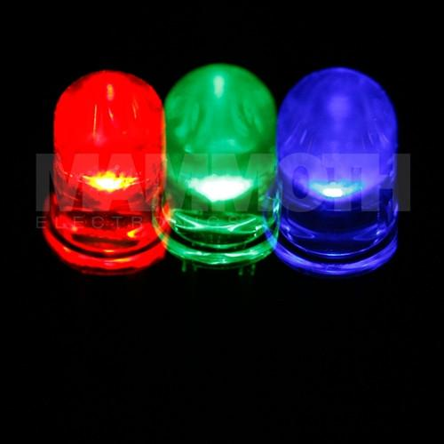
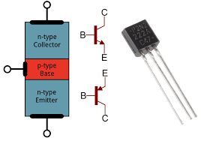
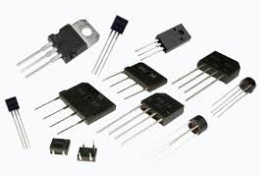
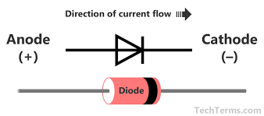
Components:

Slide 6
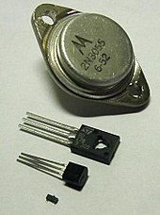
Slide Title
TRANSISTOR:
A transistor is a semiconductor device used to amplify or switch electronic signals and electrical power.
the controlled (output) power can be higher than the controlling (input) power, a transistor can amplify a signal.

Slide 7
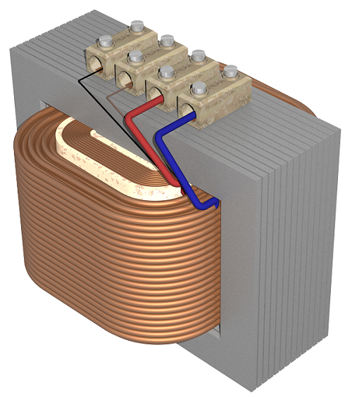
Slide Title
TRANSFORMER :
A transformer is an electrical device that transfers electrical energy between two or more circuits through electromagnetic induction.
In our CKT its used as step down transformer.

Slide 8
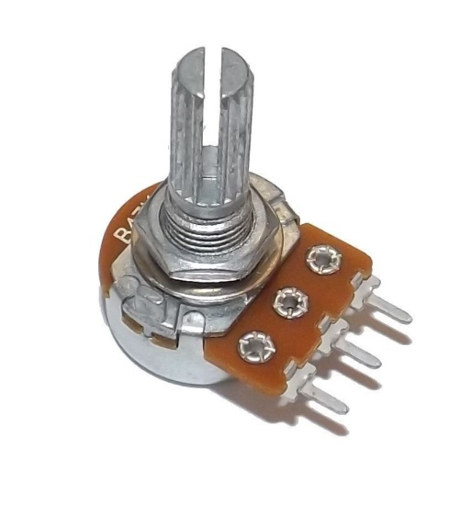
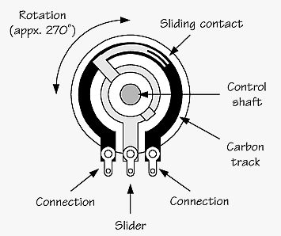
Slide Title
VARIABLE RESISTOR :
A variable resistor is very important. It allows you to build a circuit with some degree of control.
It can act as a control on the amount of current flowing.

Slide 9
DC POWER SUPPLY
DC voltage is used to operate the electronic device or circuit.
The symbol for DC voltage is Vcc for most of the electronic circuit .
It consists of:
transformer.
diode bridge.
filter capacitor.

Slide 10
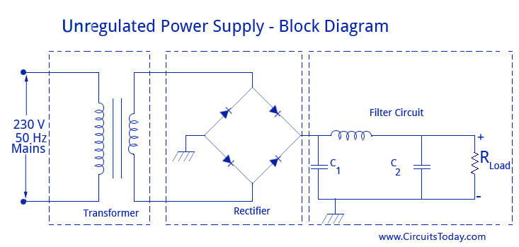
Slide Title
DC POWER SUPPLY…!!!

Slide 11
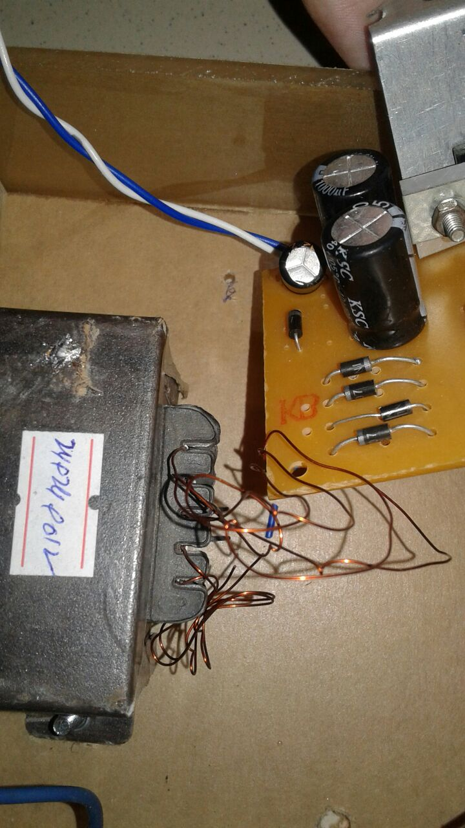
Our DC supply CKT:

Slide 12
STAGES INVOLVED IN MAKING AMPLIFIER:
3 STAGES:
Input Stage..noise reduction.
Pre-amplification..gain stage.
Power amplification..Output stage.

Slide 13
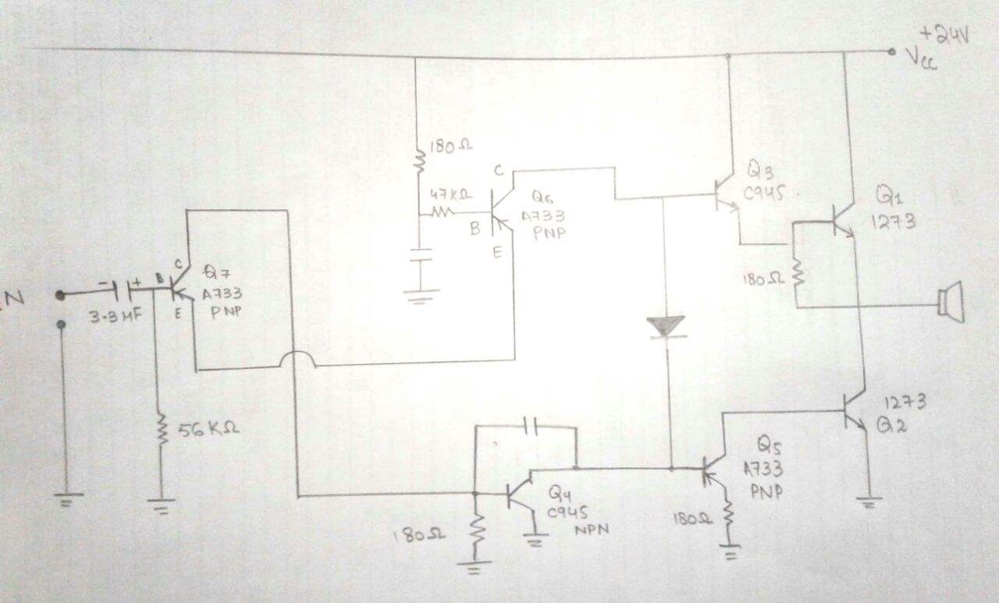
Components:

Slide 14
STAGES INVOLVED IN MAKING AMPLIFIER:
The first stage is input stage in which main focus is noise reduction and only AC signal is allowed to pass.
Second stage refers to the pre amplification in which main focus is to convert a weak electrical signal into an output signal strong enough to be noise-tolerant and strong enough for further processing .They provide voltage gain.
Last stage is the power amplification. The power amplifier provides the higher current necessary to drive loudspeakers.

Slide 15
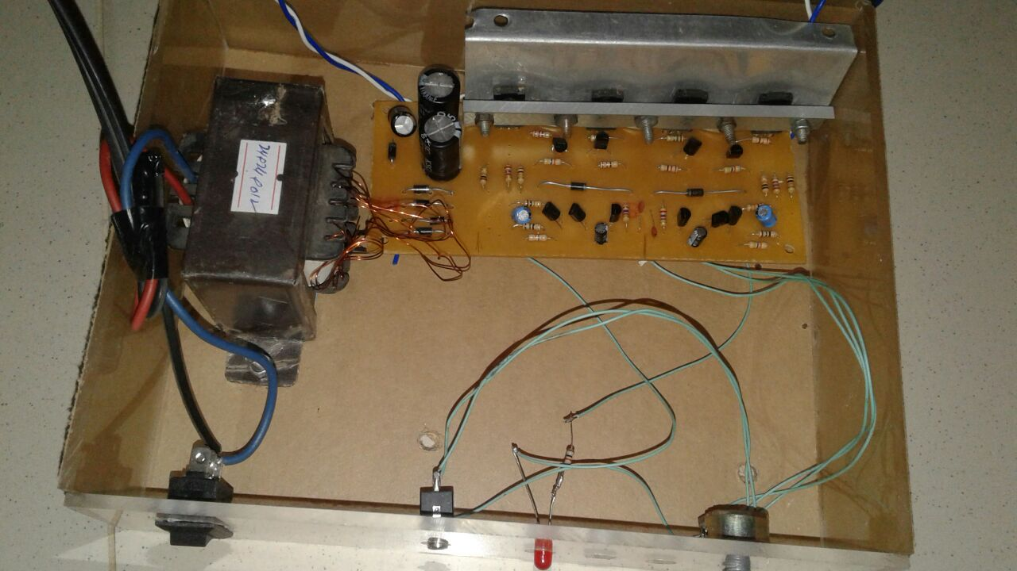
OUR TRANSISTOR AMPLIFIER..!!

Slide 16
Thank you!
Any Questions?

